Slide 1


DevOps Database Implementation for FOX Portal Scripts

Slide 2
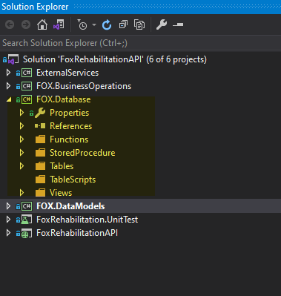
New Layer Addition
Added new layer “FOX.Database” in FOX Portal API so that the scripts can be added/modified from the API solution and to maintain the history as well.

Slide 3
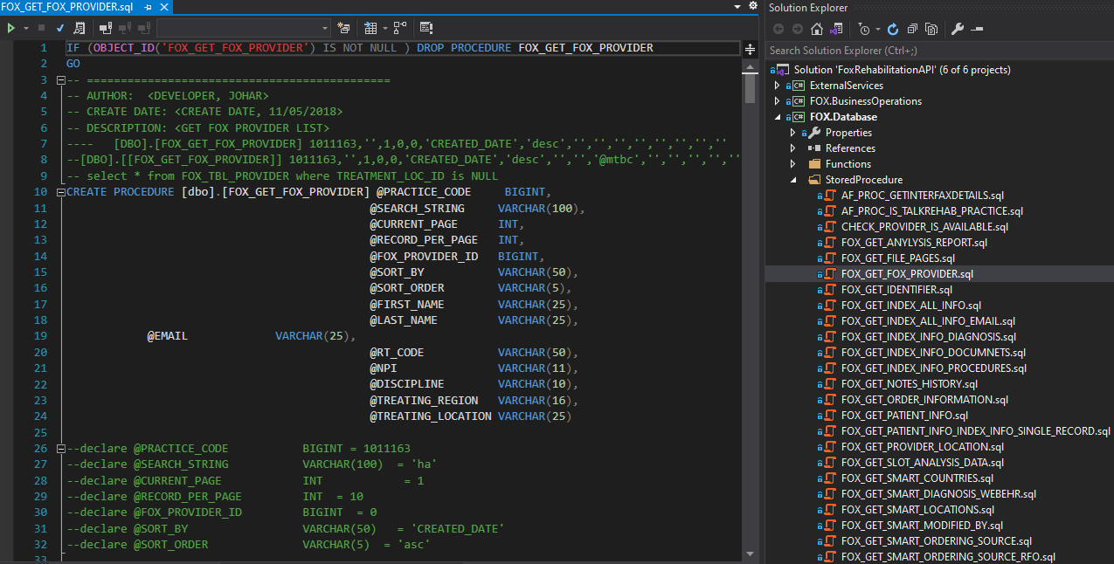
Script View
As shown in the below image user can view the script in given format.

Slide 4
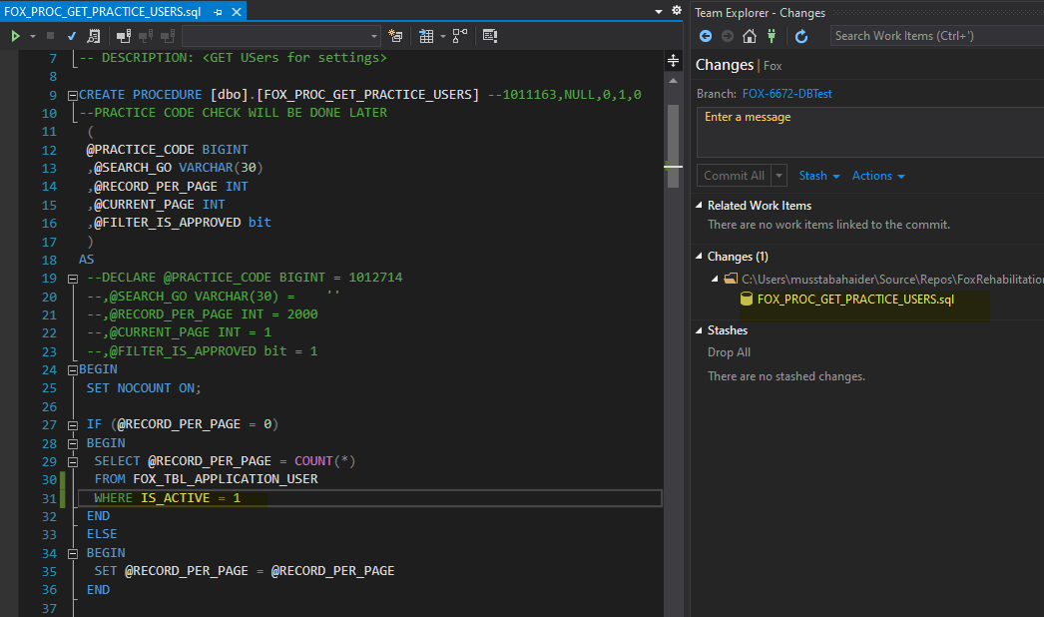
Script Updation
The changes made by the user will reflect in GIT pending changes as highlighted in below image.

Slide 5
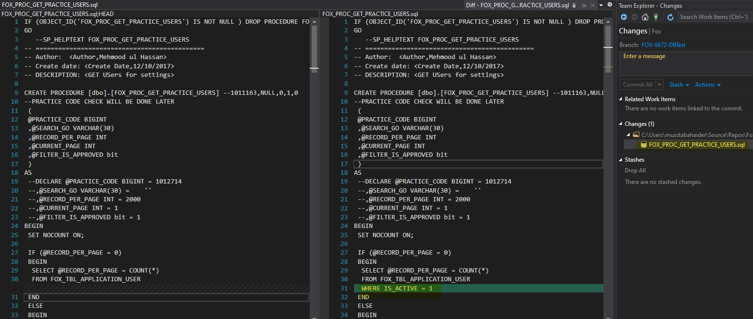
Script Comparison
After making changes in the existing script user can compare the changes with previous script.

Slide 6
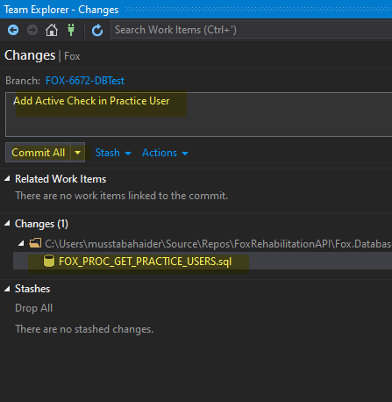
Commit Changes
Once the verification of changes has been done by the user. User will add change title and commit changes.

Slide 7
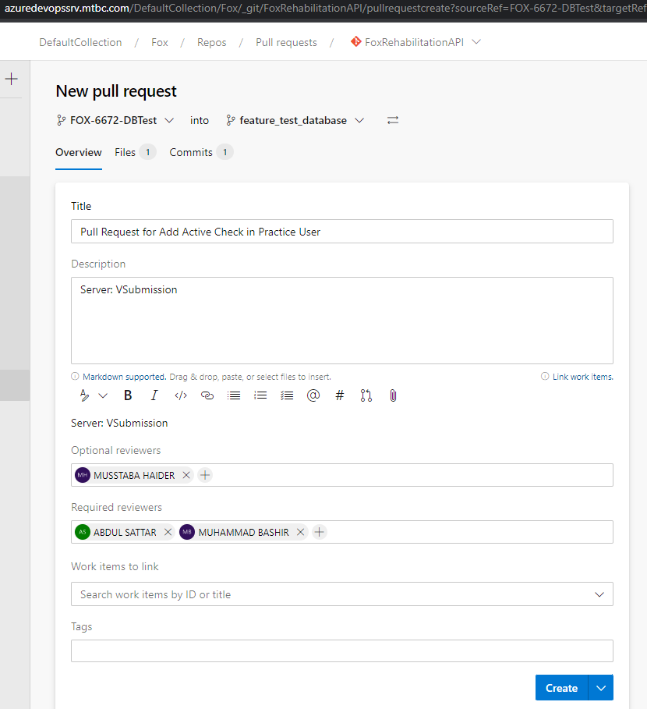
Create Pull Request
After commit changes user will create pull request for script review. Pull Request will be sent to Dev Tech Lead and assigned Database member.

Slide 8
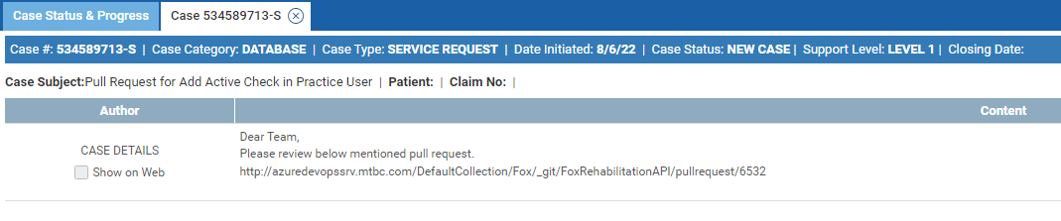
Create Ticket
After creating pull request user will generate ticket for Database category. Pull request and case title will be same for record purpose.

Slide 9
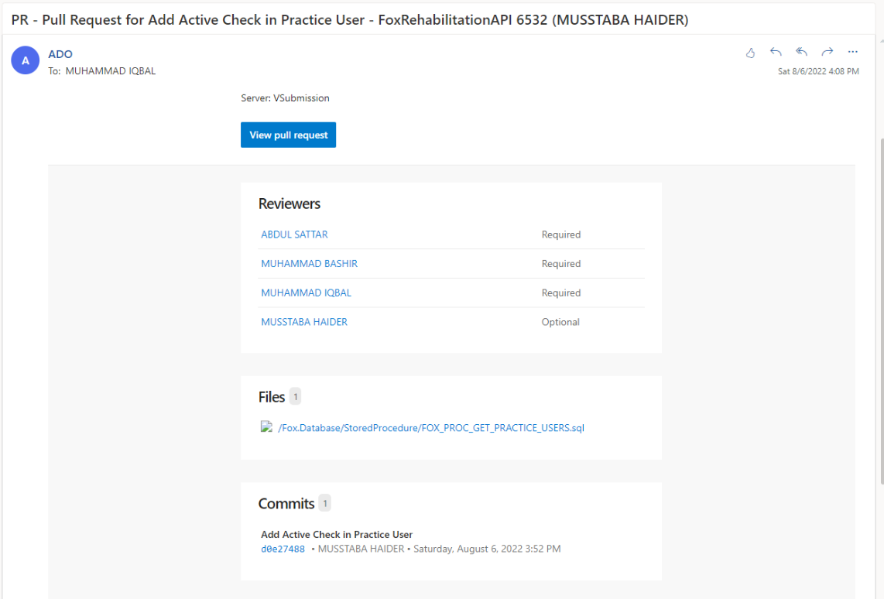
Pull Request Email
On pull request creation an auto email will be sent to reviewers.

Slide 10
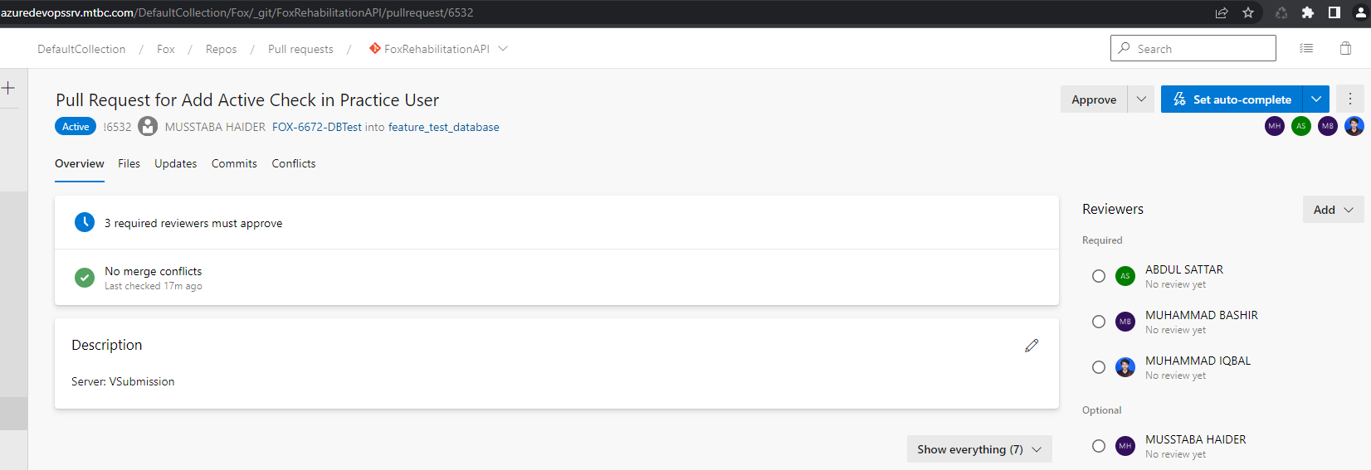
View Pull Request
Reviewer can review the request while clicking on the link sent in an email.

Slide 11
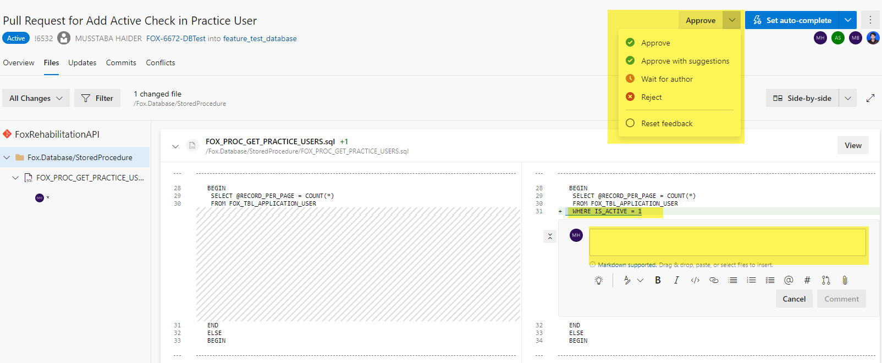
Review Changes
While reviewing reviewer can add comments, approve or reject the request.

Slide 12

Thank you

